Slide 1
Shahid Virpatni Lakshmi Mahavidyalaya, Titave
Department of Home Science ( Food Science & Nutrition)
Class : TY Sem :V
Topic: Basic of food science and Technology
Presented By: Miss. Gayatri. M. Patil

Slide 2
Definition of food
Something the human beings or animals eat is called as food.
OR
Something Consisting essentially of protein, carbohydrate, fat, and other nutrients used in the body of an organism to sustain growth and vital processes and to furnish energy is known as food.

Slide 3
Important function of food
Food provides our bodies with what they need to:
Stay alive, be active, move and work.
Bild new cells and tissue for growth.
Stay healthy and heal themselves .
Prevent and fight infection.

Slide 4
Definition of Food science
Food science is the basic science and applied science of food
The study of chemical and physical properties of food and of changes that may occur during processing, storage is known as food science.
AIM of food
To understand the changes and control them in order to obtain food products.
Which have desirable characterist

Slide 5
Objective of studying food science
To understand the function of food.
To know how to select food to meet our need for nutrients for available food.
To understand the composition of food and the changes that occur during preparation.
To lern the method of food preparation .
The economic management of food budget to meet families needs.

Slide 6
Definition of food technology
Food technology is the application of food science to the selection, preservation , processing, packaging, distribution and use of safe food.
It can also be said of branch of food science that deals with the production process that make food.
Nicolas Apperts is also called father of food technology. Because he develop canning process.

Slide 7
Composition of food
Food composition played an important role in determining what is in the food and is the critical bridge between the nutrition health promotion disease prevention and food production.
The energy components of food include:
Carbohydrates
Protein
Lipids

Slide 8
The Non energy components of food include:
  Vitamins
  Minerals
  Dietary fiber
  Water

Slide 9
Classification of food
Classification of food on the basis of it’sperihability:
Perishable food:
The food which detoriorate ( spoil) quick after harvest or slaughtring are called as perishable food.
It includes vegetables,soft fruits, meat, poultry and fish etc.

Slide 10
Semi- perishable food:
These are the food’s which contain natural inhibitor to delay spoilage
This category include root,vegetables,honey etc.
Non- perishable food:
This food which do not spoil readily are called now perishable foods.
Includes nuts, resins, cereals etc.

Slide 11
Classification of food on the basis of it’s function:
Energy yielding food:
They supply Energy.
E.g:cereals, millets, tubers, oilseeds, etc.
Body building food:
The foods which are rich in protein are called body building foods.
They include pulses, oilseeds and animal products.
E.g. Eggs, fish, milk, meat, etc.

Slide 12
Protective food
They protect the human body from disorders and deficiency diseases.
E.g. Green leafy vegetables, fruits, cod liver, etc.

Slide 13
Classification of food on the basis of Resources
1 Terrestrial foods
a) Plant foods: These are obtained from plant source. For example: cereals, fruits and vegetables, etc.
B) Animal foods: These are obtained from animal source.
For example: eggs, milk, meat, etc.

Slide 14
2 Non-terrestrial foods
These foods are cultivation in sea or water. They include fishes, lobsters, etc.

Slide 15
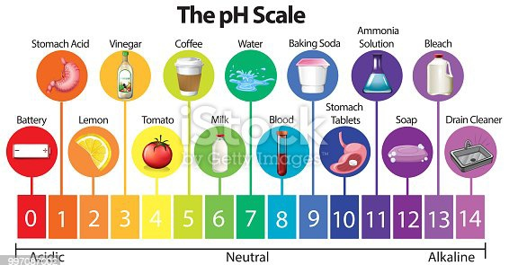
Classification Of the Food ON THE BASIS OF PH

Slide 16
Classification Of the Food INTO GROUPS
A food group is a collection of foods that share similar nutritional properties or biological classifications. The food can be classified into 11 different food groups.
Cereals
Legumes & Pulses
Nuts and Oilseeds
Vegetables
Fruits
Milk and Milk Products
Sugar foods
Fat and oils
Egg and Egg products
Flesh food
Spices and Condiment
Beverages

