Slide 1

Shahid Virpatni Laxmi Mahavidyalaya, Titave
Department of Science
Miss. Swati Shashikant Powar
M.Sc (Microbiology)

Slide 2
DNA Replication in Prokaryotes

Slide 3
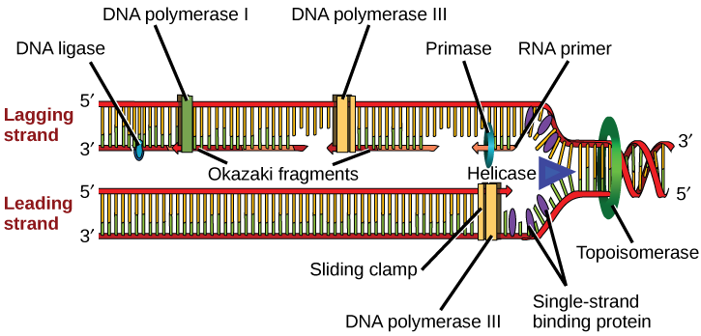

Slide 4
DNA Replication Steps
1.Initiation
2.Elongation
3.Termination

Slide 5
Role of Enzymes in DNA Replication
1.DNA-dependent DNA polymerase
DNA polymerase is of three types
2.DNA Polymerase I
It is a DNA repair enzyme. It is involved in three activities:
5′-3′ polymerase activity
5′-3′ exonuclease activity
3′-5′ exonuclease activity
3.DNA Polymerase II
It is responsible for primer extension and proofreading.
4.DNA Polymerase III
It is responsible for in vivo DNA replication.

Slide 6
5.Helicase
Helicase is the enzyme, which unzips the DNA strands by breaking the hydrogen bonds between them. Thus, it helps in the formation of the replication fork.
6.Ligase
Ligase is the enzyme which joins together the Okazaki fragments of the discontinuous DNA strands.
7.Primase
This enzyme helps in the synthesis of RNA primer complementary to the DNA template strand.
8.Endonucleases
These produce a single-stranded or a double-stranded cut in a DNA molecule.5

Slide 7
DNA Replication Process in Prokaryotes
The two strands of DNA unwind at the origin of replication.
Helicase opens the DNA and replication forks are formed.
The DNA is coated by the single-strand binding proteins around the replication fork to prevent rewinding of DNA.
Topoisomerase prevents the supercoiling of DNA.

Slide 8
5.RNA primers are synthesised by primase. These primers are complementary to the DNA strand.
6. DNA polymerase III starts adding nucleotides at the end of the primers.
7.The leading and lagging strands continue to elongate.
8.The primers are removed and the gaps are filled with DNA Polymerase I and sealed by ligase.

Slide 9
THANK YOU

