Slide 1
SHAHID VIRPATNI LAXMI MAHAVIDYALAY TITAVE
B.SC FY
SUBJECT :- ZOOLOGY
NERVOUS SYSTEM

Slide 2
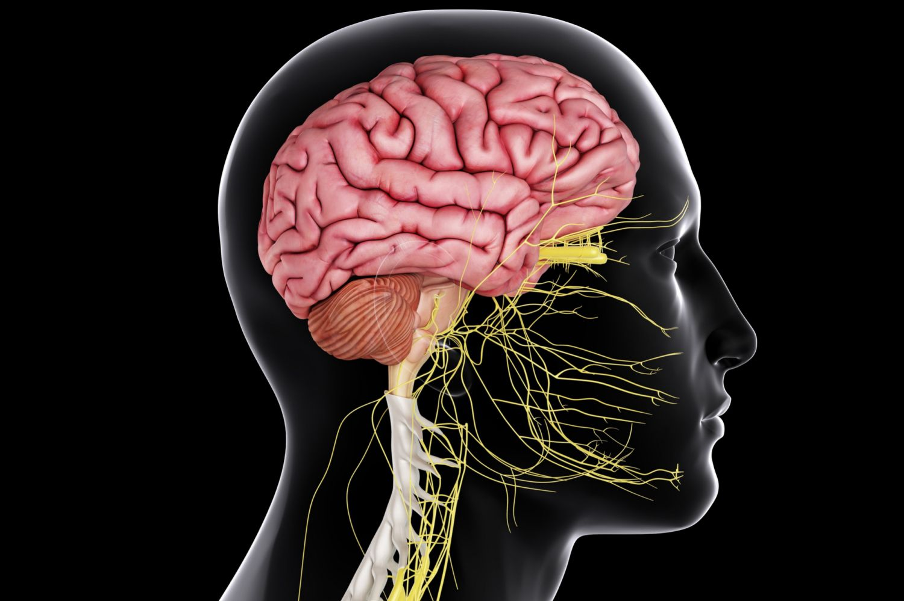

Slide 3
The nervous system includes the brain, spinal cord, and a complex network of nerves.
nervous system is the highly complex part of an animal that coordinates its actions and sensory information by transmitting signals

Slide 4
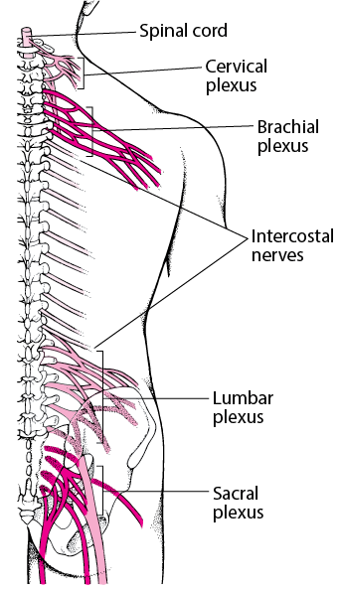
NERVE PLUXES :-

Slide 5
Nerve Plexus Locations
Nerve bundles forming a plexus are also located throughout your body.
There are two major groups of nerve plexuses: the spinal plexus and the autonomic plexus.
There are five distinct plexuses in each. They are named based on the location or function of the plexus.

Slide 6
Function of a Plexus of Nerves :-
A plexus of nerves can be thought of as an electrical junction box. Various nerves come together, are sorted, and then travel on to their respective muscles or anatomical structures to communicate signals to and from your brain.

Slide 7
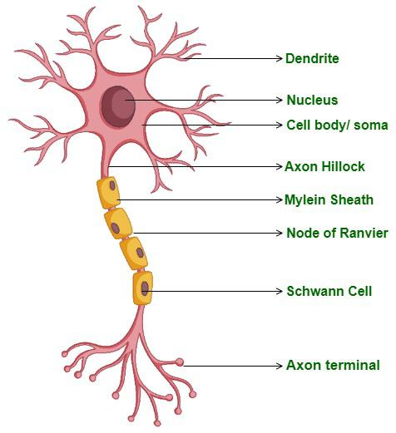
What is a Neuron?
The neuron is the basic fundamental cell of the nervous system which helps in the transmission of signals from one part to the other part of the body.
A neuron can be defined as a nerve cell that transmits information from one part of the body to another through neural impulses. Neurons receive and transmit signals to different parts of the body. This transmission process can be carried out both in physical and electrical forms.

Slide 8
The cell body is also known as Soma. The cell body has a variable size and shape.
The cell body consists of the nucleus which is enormous and is able to show its nucleolus.
The cell body also consists of the Mitochondria, Golgi apparatus, pigment granules, neurofibrils, and Neuro tubules in the Cytoplasm which supports the Neuron. The rough endoplasmic reticulum is seen in Nissl granules which extend into dendrites, but an absent in axon Hillock. Neurons do not contain centrioles so they cannot divide.

Slide 9
Cell Processes (Neurites)
This is defined as any projection from the cell body of the neuron. The projection can be an axon or a dendrite. These are the extensions of the cell body. These contain the following components.
Dendrites
Dendrites are tree-like structures (dendritic trees) that are designed to receive communications from other cells. They are 2 micrometers in length. They receive signals from various neurons and process and transfer the signals to the cell body.

Slide 10
Human Brain
The human brain controls nearly every aspect of the human body ranging from physiological functions to cognitive abilities.
It functions by receiving and sending signals via neurons to different parts of the body.
The human brain, just like most other mammals, has the same basic structure, but it is better developed than any other mammalian brain.
Human Brain
Brain Diagram
Location
Human Brain Parts
.

Slide 11
The Human Brain
On average, an adult brain weighs between 1.0 kg – 1.5 kg. It is mainly composed of neurons – the fundamental unit of the brain and nervous system.
Recent estimates have suggested that the brain contains anywhere between 86 billion to 100 billion neurons.
The brain, along with the spinal cord, constitutes the central nervous system. It is responsible for thoughts, interpretation and origin of control for body movements.

Slide 12
Parts of Human Brain
Following are the major parts of the human brain:
Forebrain – Largest part of the brain
It is the anterior part of the brain. The forebrain parts include:
Cerebrum
Hypothalamus
Thalamus
Forebrain Function: Controls the reproductive functions, body temperature, emotions, hunger and sleep.
Fact: The largest among the forebrain parts is the cerebrum. It is also the largest part of all vertebrate brains.

Slide 13
Midbrain: Smallest and central part of the brain
The midbrain consists of:
Tectum
Tegmentum
Hindbrain: The lower part of the brain
The hindbrain is composed of:
Cerebellum
Medulla
Pons
Hindbrain functions: The three regions of the hindbrain coordinates all processes necessary for survival. These induce breathing, heartbeat, sleep, wakefulness and motor learning.

Slide 14
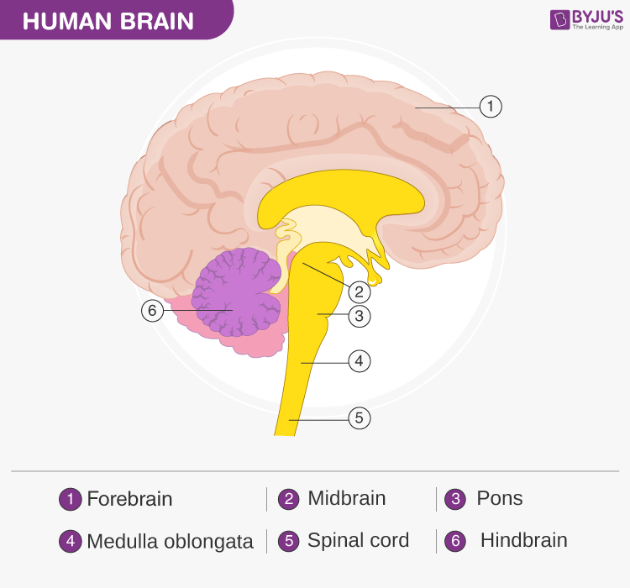

Slide 15
Cerebrum
The cerebrum is the largest part of the brain. It consists of the cerebral cortex and other subcortical structures. It is composed of two cerebral hemispheres that are joined together by heavy, dense bands of fibre called the corpus callosum. The cerebrum is further divided into four sections or lobes:
Frontal lobe: It is associated with parts of speech, planning, reasoning, problem-solving and movements.
Parietal lobe: Help in movements, the perception of stimuli and orientation.
Occipital lobe: It is related to visual processing.

Slide 16
Temporal lobe: This region is related to perception and recognition of memory, auditory stimuli and speech.
The brain consists of two types of tissues: Grey matter and White matter.
Grey matter mainly consists of various types of cells, which make up the bulk of the brain.
White matter is primarily composed of axons, which connect various grey matter areas of the brain with each other.
The exterior portion of the cerebrum is called the cortex or the cerebral mantle. The cortex is extremely convoluted, due to which, it has a large surface area. The cerebrum also includes:

Slide 17
Sensory areas: To receive the messages.
Association areas: These areas integrate the incoming sensory information. It also forms a connection between sensory and motor areas.
Motor areas: This area is responsible for the action of the voluntary muscles.
Cerebrum Function
The cerebrum is responsible for thinking, intelligence, consciousness and memory. It is also responsible for interpreting touch, hearing and vision.

Slide 18
Thalamus
The thalamus is a small structure, located right above the brain stem responsible for relaying sensory information from the sense organs. It is also responsible for transmitting motor information for movement and coordination. Thalamus is found in the limbic system within the cerebrum. This limbic system is mainly responsible for the formation of new memories and storing past experiences.

Slide 19
Hypothalamus
The hypothalamus is a small and essential part of the brain, located precisely below the thalamus. It is considered the primary region of the brain, as it is involved in the following functions:
Receives impulses
Regulates body temperature
Controls the mood and emotions
Controls the sense of taste and smell
Synthesises the body’s essential hormones
Coordinates the messages from the autonomous nervous system
Controls appetite, peristalsis, the rate of heartbeat, and blood pressure
Forms an axis with the pituitary gland which is the main link between the nervous and the endocrine systems

Slide 20
Cerebellum
The cerebellum is the second largest part of the brain, located in the posterior portion of the medulla and pons. The cerebellum and cerebrum are separated by cerebellar tentorium and transverse fissure.
Cortex is the outer surface of the cerebellum, and its parallel ridges are called the folia.
Apart from this, the cerebellum has the cerebellar peduncles, cerebellar nuclei, anterior and posterior lobes. The cerebellum consists of two hemispheres, the outer grey cortex and the inner white medulla.
It is mainly responsible for coordinating and maintaining the body balance during walking, running, riding, swimming, and precision control of the voluntary movements.

Slide 21
functions of the cerebellum include:
It senses equilibrium.
Transfers information.
Coordinates eye movement.
It enables precision control of the voluntary body movements.
Predicts the future position of the body during a particular movement.
Both anterior and posterior lobes are concerned with the skeletal movements.
The cerebellum is also essential for making fine adjustments to motor actions.
Coordinates and maintains body balance and posture during walking, running, riding, swimming.

Slide 22
Medulla Oblongata
The medulla oblongata is a small structure present in the lowest region of the brain. It mainly controls the body’s autonomic functions such as heartbeat, breathing, and digestion. It plays a primary role in connecting the spinal cord, pons and the cerebral cortex. Also, it helps us in maintaining our posture and controlling our reflexes.
Pons
The pons is the primary structure of the brain stem present between the midbrain and medulla oblongata. It serves as a relay signals between the lower cerebellum, spinal cord, the midbrain, cerebrum and other higher parts of the brain. The main functions of the pons include:
Controlling sleep cycles.
Regulating the magnitude and frequency of the respiration.
Transfers information between the cerebellum and motor cortex.
Pons is also involved in sensations, such as the sense of taste, hearing and balance.

Slide 23


