Slide 1
Shahid Virpatni Lakshmi Mahavidyalaya, Titave
Department of Home Science ( Food Science & Nutrition)
Class : FY Sem II
Topic : Principles of Use of Audio
/ Visual Aids
Prsented By : Miss. Gayatri. M. patil

Slide 2
Objectives
At the end of presentation you will be able to:
  Define learning resources
  List learning resources
  Choose the most appropriate audio / visual aids.

Slide 3
Define Learning
The process by which relatively permanent changes occur in behavioral potential as a result of experience. (Anderson)
The process of acquiring knowledge, attitudes, or skills from study ,instruction, or experience. (Miller &Findlay)

Slide 4
Define Resources
The term, resources, is normally used to describe funds.
"A source of supply or support; available means" (Webster’s).
In medical education it is used for supports that helps in teaching.

Slide 5
What are learning resources
The inputs used in the process of acquiring knowledge, attitudes, or skills from study,instruction, or experience.
They could be classified as electronic or non electronic

Slide 6
Learning Resources
Non electric
  Books
  Handouts
  Chalk and board
  Nankeens
  Models
  Flip charts
Electric
  Over head projector
  Slide projector
  Computer

Slide 7
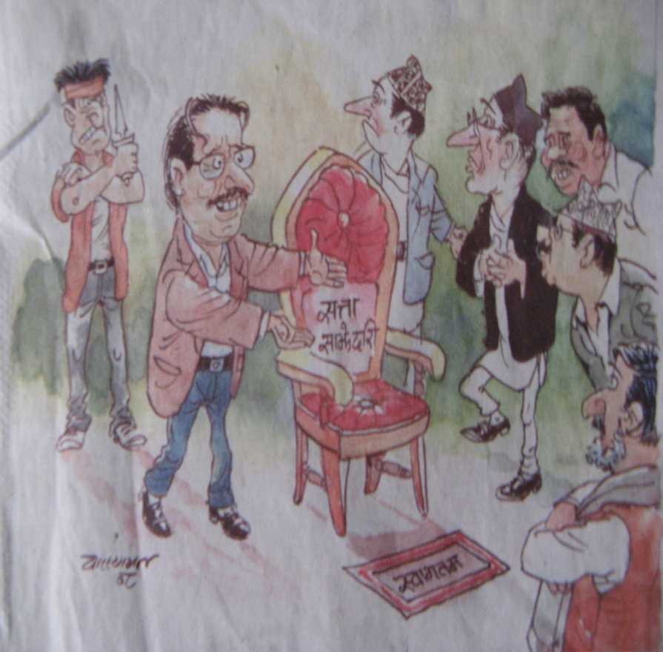
One picture worth ten thousand words: old Chinese Proverb.
I believe you can talk for thirty minutes on this cartoon.

Slide 8
Most people believe that a presentation with visual aids is more persuasive.
improve communication effectiveness
improve audience’s perceptions of presenter
improve speaker’s confidence
Notes:
Two much-quoted studies by the 3M/Wharton School (A Study of the Effects of the Use of Overhead Transparencies on Business Meetings, Wharton Applied Research Center, Wharton School, University of Pennsylvania, 1981) and the University of Minnesota/3M (Vogel, Douglas R., Gary W. Dickson, and John A. Lehman, Persuasion and the Role of Visual Presentation Support: The UM/3M Study, 1986) conclude that visual aids:

Slide 9
The wonder of PowerPoint Presentation
PowerPoint is not synonymous with presenting or teaching, with visual aids or even with a computer projector. An effective presenter must be familiar with, as Aristotle put it 2500 years ago, “all the available means of persuasion.” (Rhetoric, 1355b, 25)

Slide 10
Things you can do with a computer projector.
Demonstration.
Discussion or analysis
Animation or reference source.
Quotation for discussion.
You can project a white board that allows for more free form discussion.

Slide 11
PowerPoint, however, has notable weaknesses.
It's too easy to create slides.
It wastes time.
It takes too much control away from the presenter.
It makes for ugly presentations.
It does not lend itself to spontaneous discussions

Slide 12
PowerPoint, however, has notable weaknesses.
It too easily becomes a replacement for the presenter, not a reinforcement.
Presenters rely too much on the slides for structure.
Presenters fail to establish the connections necessary to make their message memorable.
Presenters fail to establish ethos, their most powerful appeal.

Slide 13
Why do you need to use audio-visual aids in your lesson?
a. To maintain a high level of interest in the lesson
b. To get students to use the knowledge at the beginning stages
c. To promote greater student participation
d. They can be used at all levels of learning

Slide 14
Points to be considered
Quality of material to be used.
Appropriateness to the subject.
Group to whom it is to be used.
Availability of material
Availability of facilities for its use.
Manner in which it is to be used.

Slide 15
Audio & Video Equipment:
  Load all speakers’ presentations onto hard drive of one computer
  Have a back-up disk or CD-ROM of all presentations.

Slide 16
Layout and Design:
View your presentation on your computer screen from a distance of 10 feet. If you are having trouble reading your monitor, the effect will be the same when projected.
Text placement should be consistent
Make sure there is good contrast between the text and background

Slide 17
Backgrounds:
Stick with a single and simple background. Too many "busy" items detracts from the content.

Slide 18
Colors:
Select colors that are easy on the eye for several minutes of viewing
Keep intense colors to a minimum

Slide 19
Text Size:
Projected text should be large enough to be read by all viewers (even the people in the back of the room).
  Headline text: 36-44
  Sub text: 34-36
  Second level text: 24-28
24 point is a minimum for most situations.

Slide 20
Text Size:
Remember, as text size decreases, it becomes more difficult to read
For individual playback, text size can be reduced to no smaller than 12-14 points
Try to keep sub text to 7 lines

Slide 21
· Font Style:
Select simple bold styles
Select a standard system font. This helps ensure visual consistency when the presentation is displayed from a different computer than the one it was created on.
ALL CAPITALIZED LETTERS ARE DIFFICULT TO READ AND SHOULD BE AVOIDED.

Slide 22
Images:
DO use images to supplement your message
DO use images to emphasize your point
DO NOT use an image as a space filler
DO NOT use redundant images

Slide 23
Animation:
Animation can help focus the viewers attention. But it should be kept simple and used sparingly.
Keep it in the same folder

Slide 24
Additional Presenter Tips:
Arrive early
Check out the equipment, lights, and set-up
Get oriented to rooms, lighting, and A/V
Brush up on giving your presentation
Give yourself time to feel prepared and confident

Slide 25
Overhead Projector
Face to face contact with audience
Projector located in front of room and near speaker for easy access
Can be used to focus audience's attention
Effective in a fully-lighted room; audience can follow handouts or take notes
Ability to modify transparencies during presentations

Slide 26
Overhead Projector
Sequence of material can be modified during presentation
Unframed transparencies easy to store and transport; easily fit in file folder
Overlays can be used to simplify complex information into layers
Short lead time (minutes) for preparation of transparencies
Low cost of transparency material

Slide 27
Disadvantages of Overhead Projectors
Continuous tone color transparencies are costly
Overhead projector is bulky and heavy to transport
Framed transparencies are bulky and difficult to store
Pages from books cannot be used effectively without modification since text will usually be too small for audience to read.
Overhead projection is perceived as being "less professional" than slides in a formal setting.

Slide 28
Presentation Techniques for Overhead Projectors
Use ON - OFF switch to focus attention
  ON to focus attention on visual
  OFF to focus attention on speaker
Turn the projector off when you're not using it for extended periods of time to reduce distraction for audience.

Slide 29
Presentation Techniques for Overhead Projectors
  Use projector stage like a chalkboard
        Acetate sheet or roll
        Water soluble transparency pen
  Notes for presentation can be:
        Projected with presentation
        Added in conjunction with presentation
        Revealed one point at a time
  Points in group discussions can be:
        Listed to verify communication
        Used to focus further discussion

Slide 30
Presentation Techniques for Overhead Projectors
Pointing for emphasis
  Concentrate attention on message being covered
  Use opaque shapes like pens, coins, arrows, etc.
Highlighting
  Use pen of different color from original. (Be sure to use water-soluble pen if you need to re-use the original transparency.)
  Use underline, circle, arrow, check, bullet, star, etc. as emphasis codes for your audience
Progressive disclosure with opaque cover
  Reveal topics one point at a time
  Direct attention to point being covered
  Prevent distraction

Slide 31
Preparing transparencies
The rule of six:
  Six lines per transparencies
  Six words per line
  Six mm smallest letter size
  Six cm (3+3 on each side) margin

Slide 32
Overhead Projection Survival Kit
Extension Cord
Plug Adapter
Spare Bulb
Transparency Pen

