Slide 1

Shahid Shikshan Prasarak Mandal Titave’s
Shahid Virpatni Laxmi Mahavidyalaya,
Titave
Department of Science
Class: FY Sem.: I
Subject: Inorganic Chemistry
Topic: Theory of Volumetric Analysis
Miss.Kajal Prakash Balugade
Assistant Professor

Slide 2

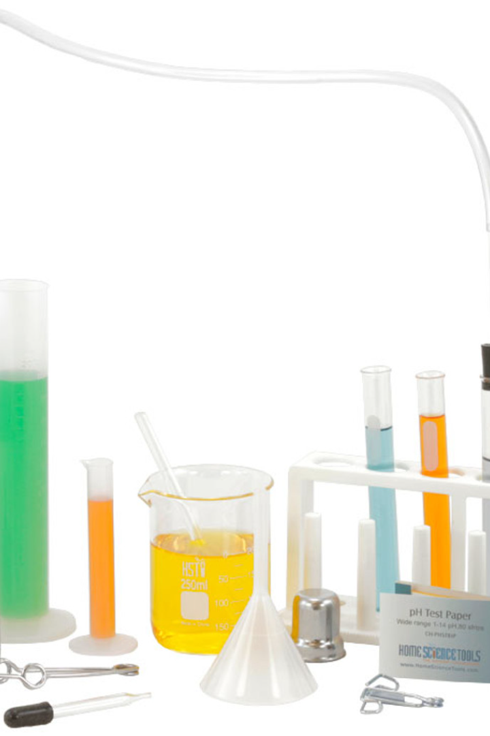
Theory of Volumetric Analysis
Welcome to the world of volumetric analysis, where precise measurements and calculations rule. This presentation will guide you through the basic principles of volumetric analysis and its practical application.

Slide 3

The Art of Precise Measurement
The Definition
Volumetric analysis is a quantitative analysis method that uses the volume of a solution to determine the amount of a substance in it.
The Principles
Volumetric analysis relies on the precise measurement of volume, the use of standardized solutions, and the classic titration process.
The Importance
This method is utilized across different industries, from medicine and chemistry to environmental science and food production.

Slide 4
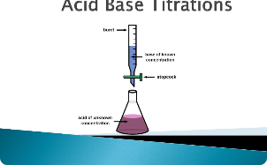
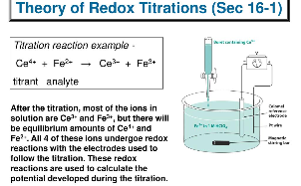
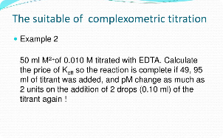
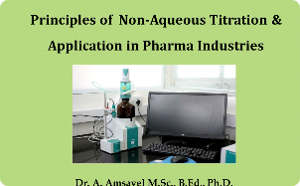
The Many Faces of Titration
Acid-Base
Redox
Complexometric
One of the most basic and commonly used types of volumetric analysis that measures the amount of acid or base in a solution.
Measures the transfer of electrons between two substances in a solution through the use of oxidation and reduction reactions.
Characterized by the formation of complex compounds to measure the amount of metal ions in a solution.
Non-aqueous
Performed in solvents other than water, primarily used to analyze organic compounds.

Slide 5
Tools and Materials of the Trade
1
Pipettes and Burettes
Used to accurately measure and transfer volumes of solutions.
Standardized Solutions
2
Designed to have a known concentration that can easily react with the sample.
3
Indicators
Substances that can change color during a titration to signal the endpoint of a reaction.
Volumetric Flasks
4
Specialized glassware used to measure and stabilize precise and accurate volumes of solutions.

Slide 6
Procedure for Volumetric Analysis
1
Measure
2
Mix
Use the appropriate tools to measure the volume of a sample and the standardized solution.
Transfer the standardized solution into the sample, and mix the two together.
3
Titrate
4
Analyze
Add the standardized solution to the sample until the endpoint is reached and recorded.
Calculate the concentration of the substance in the sample based on the amount of standardized solution used.

Slide 7
Accuracy and Precision
Accuracy
Precision
Factors Affecting Accuracy and Precision
The extent to which a measurement or result is close to the true or expected value.
The degree of mutual agreement among a series of measurements under the same conditions.
Human error
Environmental factors
Instrument calibration
Chemical impurities

Slide 8



Applications of Volumetric Analysis
Medicine
Food Production
Environmental Science
Used to determine the concentration of drugs in the bloodstream, and diagnose medical conditions through blood and urine tests.
Used to monitor the fermentation process, pH levels of food products, and detect food adulteration.
Used to monitor water quality, air pollution levels, and detect harmful substances in soil.

Slide 9
The Future of Volumetric Analysis
1
Advanced Equipment
New technology is poised to make volumetric analysis faster and more precise, with automated processes and real-time data collection.
Green Chemistry
2
The growing focus on sustainable practices in the scientific community is leading to improved methodologies and materials that are more environmentally friendly.
3
Interdisciplinary Collaboration
As the applications of volumetric analysis continue to expand, interdisciplinary collaboration across different fields will be essential for further advancements in this area.

