Slide 1
Shahid Virpatni Lakshmi Mahavidyalaya, Titave
Department of Home Science ( Food Science & Nutrition)
Class : SY Sem III
Topic :Introduction to Nutrition
Presented by : Gayatri. M. Patil

Slide 2
Introduction to Nutrition
Nutrition = the study of food.
Food = any substance which contains nutrients.
Nutrient = any substance which can be digested and used by the body.
There are six nutrients:
  Proteins,
  Fats,
  Carbohydrates,
  Minerals,
  Vitamins,
  Water
© PDST Home Economics

Slide 3
Macronutrients = nutrients required in large amounts, i.e. proteins, fats and carbohydrates.
Micronutrients = nutrients required in small amounts, i.e. minerals and vitamins.
Composition: refers to the elements that make up the nutrient and how they are arranged within the nutrient.
Classification: refers to the division into groups or classes.
Sources: refer to the foods which are the best suppliers of the nutrient.
Functions: refers to the uses of the nutrient in the body.

Slide 4
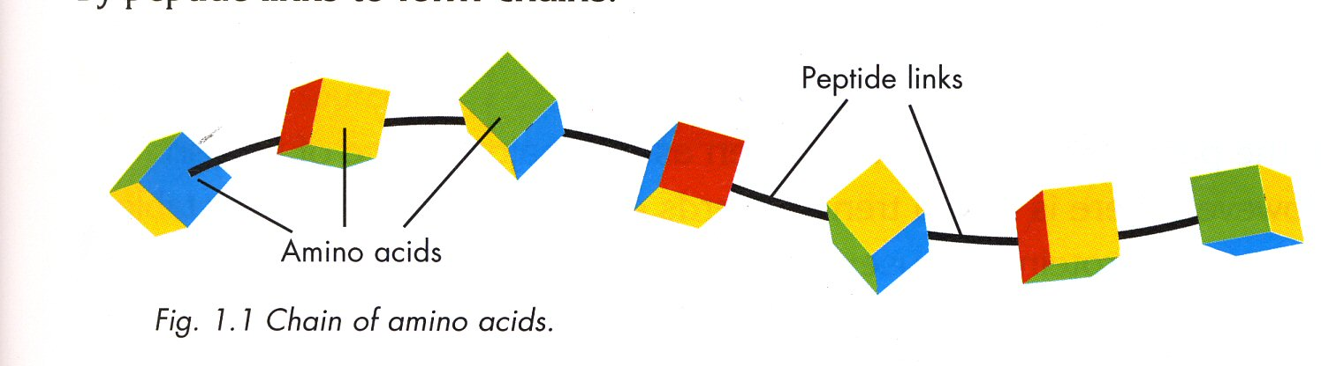
Protein
Composition
Elements: carbon, hydrogen, oxygen and nitrogen.
It is the only nutrient that contains nitrogen, which is the element responsible for growth.
These elements make up units called amino acids.
Protein is a number of amino acids joined together by peptide links to form a chain.

Slide 5
These protein chains are broken down during the digestion of food, freeing each amino acid so that it can be absorbed into the bloodstream.

Slide 6
Classification
Animal Protein / 1st.Class protein / High Biological Value (HBV)
Vegetable Protein / 2nd.Class / Low Biological Value (LBV)
Both classes of protein should be included in the diet.
The amount of protein required by each person is related to his/her weight.
RDA of protein is 1 gram of protein per kg of body weight.

Slide 7
Sources
Animal Protein: Meat, fish, milk, eggs, cheese, yoghurt
Vegetable Protein: Peas, beans, lentils, nuts, cereals
In the past animal foods were eaten as a major source of protein, there is now a trend towards eating more plant or vegetable sources of protein because:
  They contain less fat
  They contain more fibre
  They are cheaper to produce.

Slide 8
Functions
For the growth of all body cells e.g. skin and bones.
The repair of worn out or damaged cells e.g. cuts.
The production of hormones, enzymes and antibodies which are required to keep the body healthy.
Excess is used for heat and energy.

Slide 9
Amino Acids
There are approximately 20 amino acids.
There are two types:
  Essential
  Non-essential
Essential amino acids are those which the body cannot be make and must be supplied by the diet.
Non-essential amino acids are those which the body can make enough of and are not therefore a dietary requirement.

Slide 10
Fats
Fats are also called lipids.
Lipids = fats + oils.
Fats are solid at room temperature e.g. butter.
Oils are liquid at room temperature e.g. olive oil.

Slide 11
Composition
Elements: carbon, hydrogen and oxygen.
They are made up of glycerol + 3 fatty acids
During digestion the glycerol is separated from the fatty acids.
Classification
Animal fats or saturated fats.
Vegetable fats or unsaturated.

Slide 12
Sources
Animal Fats (from animal sources) | Butter, meat, oily fish, eggs, cheese, cream
Vegetable Fats (from plant sources) | Cooking oil, nuts, cereals, margarine
Functions
Fats produce heat and energy
Fats insulate the body with a layer of adipose tissue
Fats protect delicate organs e.g. Kidneys
They are a source of fat soluble vitamins – A, D, E and K

Slide 13
They delay hunger as they take longer to digest
than proteins and carbohydrates.
They add flavour to the diet.

Slide 14
Dangers Associated with Overeating Fats
Eating too much fat may result in obesity (being very overweight)
Saturated fats may lead to a build up of cholesterol in the arteries.
This may cause high blood pressure, strokes and heart disease.
Cholesterol levels rise because there is too much saturated fat in the diet.
Saturated fat is present in all animal food e.g. meat, eggs, butter.
High cholesterol leads to hardening of the arteries.

Slide 15
Cholesterol
Cholesterol is a hard waxy fat which may build up on the walls of the arteries.
This causes the arteries to become narrower.
This puts more pressure on the heart to pump the blood through smaller vessels.
High blood pressure, heart attack or strokes may result.

Slide 16
Benefits of Unsaturated Fats in the Diet
Some unsaturated fats help to reduce cholesterol in the blood.
Omega 3 and Omega 6 fatty acids are also good for brain function.
Sources of Omega fatty acids include oily fish, seeds and nuts.

Slide 17
Carbohydrates
They come from plant food.
Plants make their own food by a process called photosynthesis.
Composition
Elements present are carbon, hydrogen and oxygen.
All carbohydrates are made up of one or more single
sugar units.

Slide 18
Classification
They are divided into three groups:
Sugars
Starches
Cellulose
Sources
Sugar: cakes, biscuits, jam, honey, sugar, soft drinks
Starch: potatoes, cereals, bread, pasta
Cellulose: fruit, vegetables, whole cereals, seeds and nuts

Slide 19
Functions
Carbohydrates supply the body with heat and energy.
Extra carbohydrate is stored as fat, (adipose tissue) which insulates the body and prevents heat loss.
Cellulose aids digestion by pushing food through the intestine quickly, preventing constipation.
Cellulose also prevents diseases, e.g. cancer of the bowel

Slide 20
Cellulose
Cellulose is also called dietary fibre.
It is not digested by the body.
It is important as it aids digestion by helping to push the food through the intestines.
It stimulates peristalsis, the contraction and relaxation of the muscles of the intestine.
It helps prevent constipation and diseases e.g. cancer of the bowel.
It absorbs lots of water giving a feeling of fullness.
It is very important to include high fibre foods in the daily diet.

Slide 21
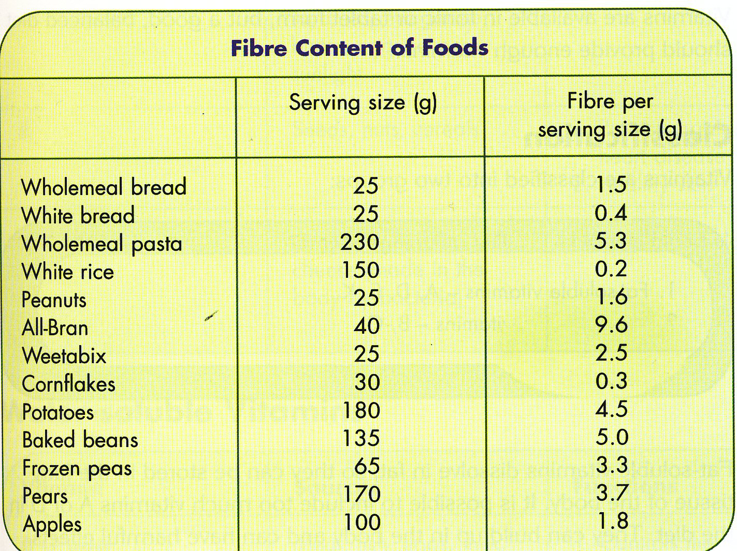
RDA for fibre is 25-30g.
The average intake is 15-20g. per day.

Slide 22
Sugar
Do not include too many foods high in sugar in the diet.
Many of these foods provide “empty kilocalories”.
Empty kilocalories: means that they contain sugar only and are lacking in all other nutrients.
Too much sugar leads to tooth decay and obesity.
Many foods contain hidden sugars, these foods may not taste sweet but may contain sugar e.g. savoury sauce mixes.
In the list of ingredients the sugar is often called other names, e.g. glucose, sucrose, maltose.

Slide 23
Reducing Sugar in the Diet
Replace sugary snacks with healthier choices, e.g. fruit and nuts.
Drink water instead of fizzy drinks.
Sweeten foods such as porridge with fresh or dried fruit.
Read food labels to check the sugar content and look for hidden sugars.

Slide 24
These are two very important
Healthy Eating Guidelines:
Increase fibre in the diet.
Decrease sugar in the diet.

