Slide 1

Shahid Virpatni Laxmi Mahavidyalaya,Titave
Department of Science
Miss.Kajal Prakash Balugade
Assistant Professor
Inorganic Chemistry

Slide 2
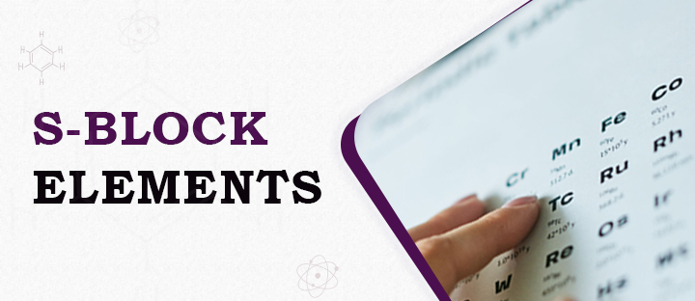

Slide 3
S Block Elements
What Are S-Block Elements?
S-block elements having only one electron in their s-orbital are called group one or alkali metals, whereas the s block elements having two electrons filling their s-orbital are called group two or alkaline earth metals.
The electrons present in an atom occupy various sub-orbitals of available energy levels in the order of increasing energy. The last electron of an atom may find itself in either of the s, p, d and f subshells. Accordingly, the elements of the atom having their last valence electron present in the s-suborbital are called s block elements.

Slide 4
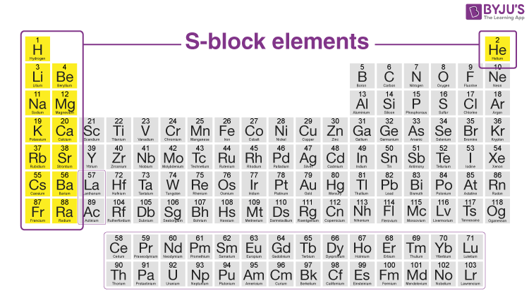

Slide 5
Electronic Configuration of S-Block Elements
The electronic configuration of S-block elements is explained below.
The alkali elements in the s-block consist of a single valence electron in their outermost shell. This outermost electron is loosely held, which makes these metals highly electropositive. Due to this, they are not available in a free state in nature. The general electronic configurations of s block elements – group 1 are as shown in the table below:
Element | Symbol | Electronic Configuration
Lithium | Li | 1s²2s¹
Sodium | Na | 1s²2s²2p⁶3s¹
Potassium | K | 1s²2s²2p⁶3s²3p⁶4s¹
Rubidium | Rb | 1s²2s²2p⁶3s²3p⁶3d¹⁰4s²4p⁶5s¹
Caesium | Cs | [Xe]6s¹
Francium | Fr | [Rn]7s¹

Slide 6
The electronic configurations of elements included in group 2 of S block elements are shown below:
elements | Symbols | Electronic Configuration
Beryllium | Be | [He]2s²
Magnesium | Mg | [Ne]3s²
Calcium | Ca | [Ar]4s²
Strontium | Sr | [Kr]5s²
Barium | Ba | [Xe]6s²
Radium | Ra | [Rn]7s²

Slide 7
Properties of S-Block Elements
The anomaly of these S-block elements is due to the following:
Low atomic and ionic size
Greater charge density (charge/volume of the atom)
Greater polarization
Absence of d-orbitals.
Greater polarization of s block elements makes the first element more covalent and differentiates them from the rest, which is ionic.
The similarity in size and charge density makes them resemble the element diagonally placed in the next group (diagonal relationship).

Slide 8
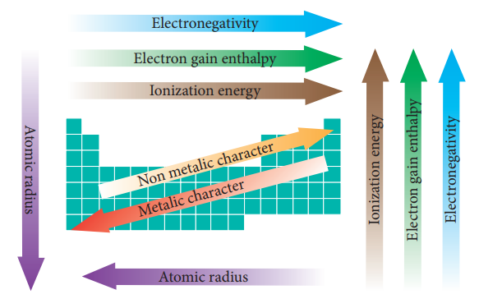

Slide 9
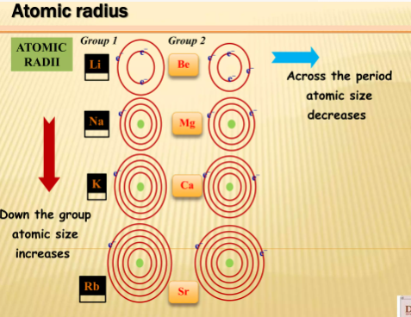
Atomic and Ionic Radii
When the s block elements of the modern periodic table are observed, it is seen that the size of the alkali metals is larger compared to other elements in a particular period. As the atomic number increases, the total number of electrons increases along with the addition of shells.
On moving down the group, the atomic number increases. As a result, the atomic and ionic radius of the alkali metals increases.

Slide 10
Ionization Enthalpy
As we go down the group, the size of the atoms increases, due to which the attraction between the nucleus and the electrons in the outermost shell decreases. As a result, the ionization enthalpy decreases. The ionization enthalpy of the alkali metals is comparatively lesser than other elements.
Hydration Enthalpy
As the ionic sizes of the elements increase, the hydration enthalpy decreases. The smaller the size of the ion, the hydration enthalpy is high as the atom has the capacity to accommodate a larger number of water molecules around it due to the high charge/radius ratio, and hence gets hydrated.

Slide 11
Physical Properties of s Block elements
In the s block elements, the density of the alkali metals increases down the group. Exception: the density of potassium is less than the density of sodium.
Alkali metals have a low melting and boiling point due to weak metallic bonding.

Slide 12


