Slide 1
Shahid Virpatni Lakshmi Mahavidyalaya, Titave
Department of Home Science ( Food Science & Nutrition)
Class : SY Sem: IV
Topic : Production of alcohols and organic acids
Presented by : Miss.Gayatri. M. Patil

Slide 2
Production of alcohols
Alcohol are vital industrially and commercially.
Commerical alcohol includes methanol, ethanol, Isopropanol, and ethylene glycol.
Ethanol is used as a solvent as a fuel additive, in medicines , lotions.
Fermentation is a chemical breakdown of a substancrs by bacteria, yeast or other microorganisms.
The fermentation of carbohydrates in to alcohol is one of the oldest process of fermentation. The fermentation start by mixing source of sugar, yeast, water and then allowing yeast to act in oxygen free environment.

Slide 3
Procedure
Commercially fermentation is the initial step for production of wine, beer, cider.
Ethanol Fermentation :
Ethanol fermentation is a biological process that converts sugar such as glucose/ sucrose into cellular energy, producing ethanol and Co2 as by – products
Fermentation is the process where yeasts breakdown into alcohol and carbon dioxide.
For fermentation process yeast such as saccharomyces cerevisae is used.
Raw material hat can be served as sustrate is glucose/ sucrose.

Slide 4
Media preparation
After the selection of the desired yeast (saccharomyces cerevisae) and it’s isolation in pure from, the incolum is prepared under aseptic conditions. The yeast is first cultured in flask to increase the size of the inuculums as it will be suitable for insulation.

Slide 5
Fermentation
For a fermentation continous fermentation is used.
For a continous fermentation, the growth of microbes is maintained in the fermenter for a longer period of time ; in the meantime the media is added at regular intervals.
Temperature and pH is maintained at 21-26 & 4.0 -4. 5 respectively.
Ethanol gets evaporated at temperature above 27 .
Firstly areation is required for good growth of organism; later anaerobic condition is created by withdrawal of oxygen coupled with the production of carbon dioxide
Then as the fermentation is complete, the fermentation broth contains ethanol in the range of 6-9% in volume which represent about 90-95 % conversion of substrate to ethanol

Slide 6
Recovery of ethanol
The mass is seperated by centrifugation in a centrifuge.
Ethanol from fermentation broth can be recovered by distillatoons.
For 100% alcohol a specific type of distillation know as azeotropic distillation is used.
For this an azeotrope mixture of benzene, water, alcohol is first prepared after which the mixture is distilled by gradually increasing the temperature.

Slide 7
Production process of organic acids
Organic acids are broadely distributed nature, and human have used them in their natural sources .
Fermentation process that involve the production of acetic and lactic acid have been used in food preparation for centuries.
Industrial production with the microbiological route was started when the acids were identified as the main product in know fermentation process.

Slide 8
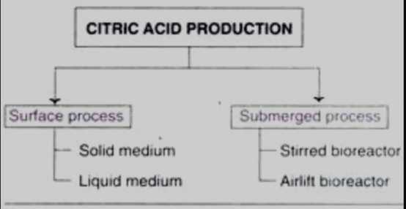
Citric acid
Citric acid was first discovered as a constituent of lemon.
Today we know citric acid as an intermediate of ubiquitous krebs cycle, and there for, it is present in every living organism.
In early days, citric acid was isolated from lemon ( that contain 7-9 % citric acid)
production process of citric acid
There are two process by which citric acid can be industrially produced the surface and submerged process.

Slide 9
Gluconic acid
Gluconic acid can be produced by several bacteria and fungi. Glucose, on a simple direct dehydrogenation, from D-gluconolactone which is then converted to gluconic acid.
Production process of gluconic acid:
Submerged process, by employing either A. Nigeria or G. Suboxidans, are used for producing gluconic acid.
The culture medium contains glucose at a concentration of 12-15% (usually obtained from corn) .
The fermentation is carried out at ph 4.5 -6. 5 and at temperature 28-30 for a period of about 24 hours.
Increasing the supply of o2 enhances gluconic acid yield.

Slide 10
Lactic acid
The isolation of lactic acid from milk was done in 1798.It was the first organic acid produced by microorganisms in 1880. Today lactic acid is competitively produced both by microbiological and chemical methods.
Production process of lactic acid:
The fermentation medium contains 12-15 % of glucose, nitrogen and phosphate containing salts and micronutrients.
The process is carried out at pH 5.5-6.5 and temperature 45-50 for about 75 hours.
Generally, the strains operating at higher temperature (45-60) are perfered, since it reduce the need for medium sterilization.
As the lactic acid is produced, it has to be removed since it is toxic to the organisms. This can achieved either by a continuous culture technique or by removal of lactic acid by elector dialysis.

Slide 11
Acetic acid
The production of acetic acid, in form of vinegar (used as a refreshing drinking), from alcoholic liquids .
Production process of acetic acid:
For every molecule of ethanol oxides, one molecule of acetic acid is produced.
Thus high- yielding strains can produce 11-12 % acetic acid from 12% of alcohol.
For optimal production adequate supply oxygen is very essential.
Insufficient O2, coupled with high concentration of alcohol and acetic acid result in the death of microorganisms.
Surface fermentation or submerged fer6 process can be carried out to produce acetic acid.

