Slide 1

Shahid Virpatni Laxmi Mahavidyalaya,Titave
Department of Science
Miss.Kajal Prakash Balugade
Designation - Assistant Professor
Subject - Inorganic Chemistry

Slide 2
Theory of Volumetric Analysis
Chemistry

Slide 3
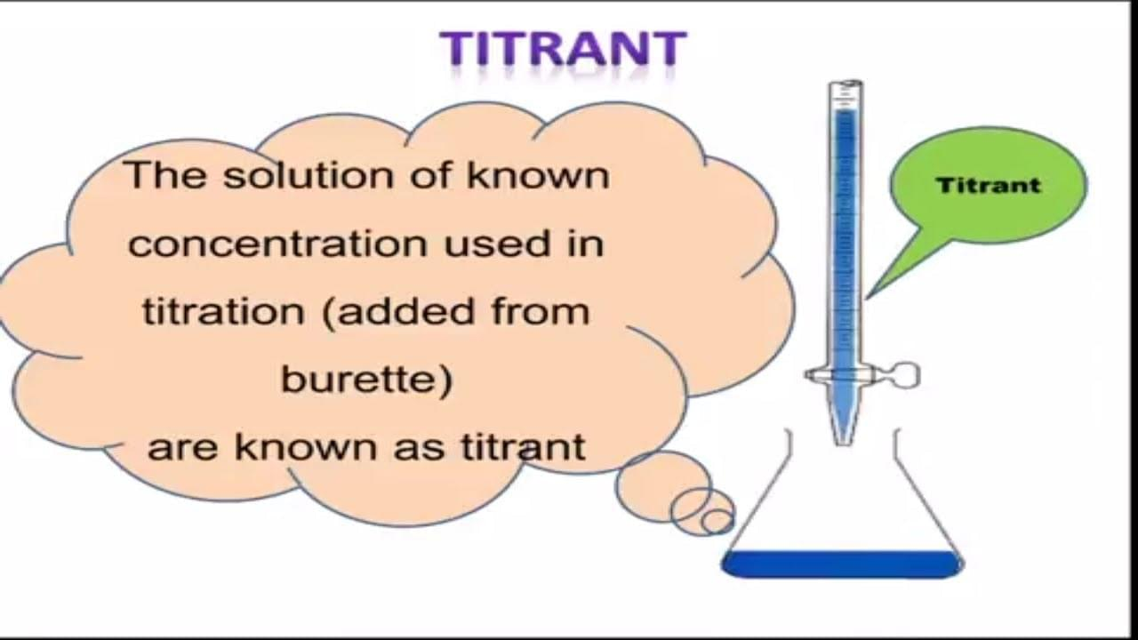
What is Volumetric Analysis?
Volumetric Analysis is the method in which the concentration of a substance in a solution is estimated by adding the same number of compounds of another substance present in a solution of known concentration. Volumetric Analysis is also known as Titration.

Slide 4
Titrant
The titrant is the component whose solution is used to determine the concentration of an unknown solution. The component whose concentration is to be estimated is known as titrate. Titrimetric analysis is another name for volumetric analysis.
Types of Titration
Titration is a category of volumetric analysis. Volumetric analysis methods involve titrations. However, the term titration is used when volumetric analysis is used to determine concentration of an unknown component in a solution.
There are three different
types of titration:
1. Simple Titration
Simple titration is used to determine the concentration of an unknown solution using the concentration of another known solution. Simple titration can be further divided into four categories:
Acid-base
Redox
Precipitation
Complexometric

Slide 5
2. Back Titration
Back titration determines the concentration of an analyte by reacting it with a known amount of excess reagent, whereas a direct titration examines the concentration of an unknown chemical directly. Excess reagents are not added in back titrations. Back titration is also known as indirect titration.
3. Double Titrations
Double titration is used to determine the amount of substance present in the form of a solution with another solution. Gilson's titration method for estimating the concentration of organometallic compounds in hydrocarbon solvents is also known as double titration. The overall concentration of the base in the solution is determined in the first stage. The residual amount of alkali after the organometallic compound reacts with the halide is determined in the second stage, allowing the concentration of the metal-organic compound to be calculated.

Slide 6
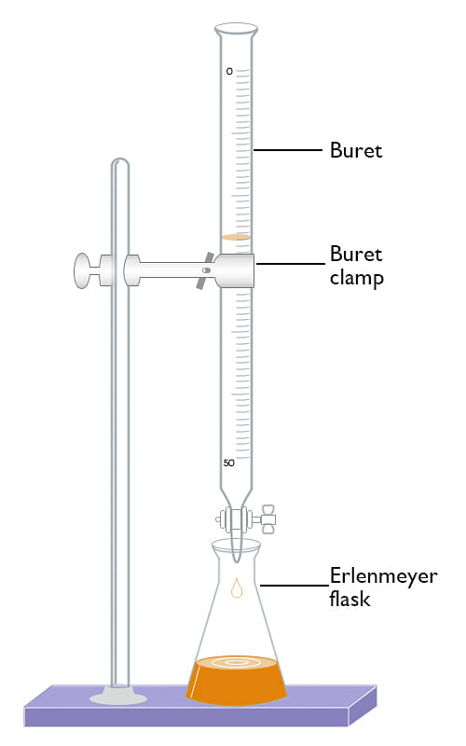
Apparatus Used for Volumetric Analysis
The apparatus used for Volumetric Analysis are:
Burette, pipette, measuring flasks, and measuring cylinders.
Flasks for general titration, beaker, tile, glass rod, funnel, weighing bottle, and wash bottle.
Weighing machine with a chemical balance
Experimental Setup

Slide 7
Principles of Volumetric Analysis
The principles of Volumetric Analysis includes:
An unknown number of chemicals must be present in the solution which needs to be examined.
To show the end-point, a reagent with an unknown concentration reacts with the chemical of an unknown amount in the presence of an indicator (usually phenolphthalein). The end-point is the point at which the reaction is finished.
The reaction between the solution and the reagent is completed by titration which is used to measure the volumes.
The amount of reagent and solution is shown by the volume and concentration of reagent used in the titration.
The mole fraction of the equation determines the amount of an unknown chemical in the specific volume of solution.

Slide 8
Procedure for Volumetric Analysis
A typical titration begins with a calibrated burette or pipette containing the titrant and a beaker or flask with a precise volume of the analyte and a small amount of indicator placed beneath it.

Slide 9
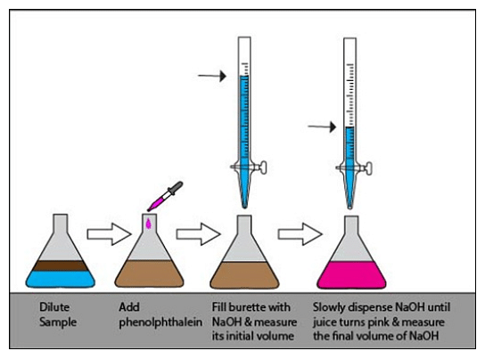
Titration Procedure

Slide 10


