Slide 1
SHAHID VIRPATNI LAXMI MAHAVIDYALAYA, TITAVE
Name- Nilam Ananda Varute
Assistant Professor
Department of Science

Slide 2
Bioreactors

Slide 3
Definition of Bioreactor
A bioreactor is a type of fermentation vessel that is used for the production of various chemicals and biological reactions. It is a closed container with adequate arrangement for aeration, agitation, temperature and pH control, and drain or overflow vent to remove the waste biomass of cultured microorganisms along with their products.
A bioreactor should provide for the following:
Agitation (for mixing of cells and medium),
Aeration (aerobic fermentors); for O2 supply,
Regulation of factors like temperature, pH, pressure, aeration, nutrient feeding, and liquid leveled.
Sterilization and maintenance of sterility, and
Withdrawal of cells/medium

Slide 4
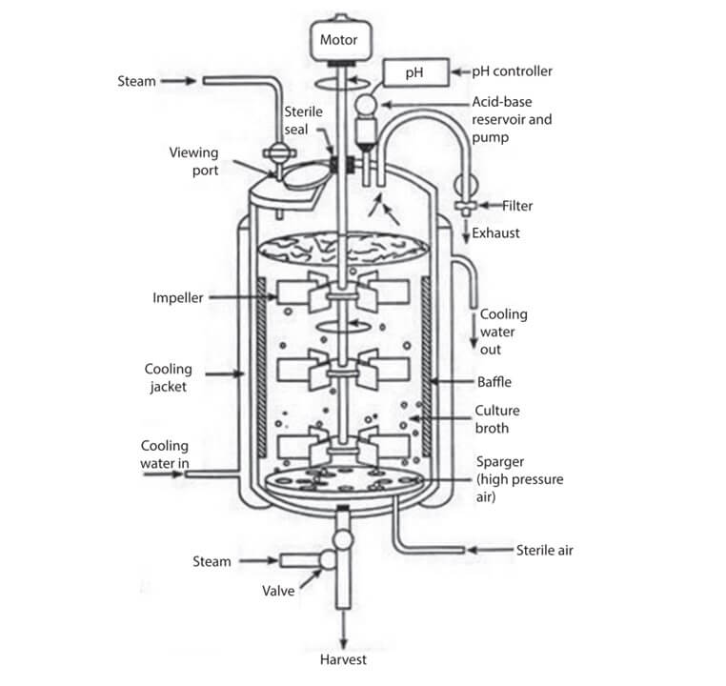
Design of Bioreactor:-

Slide 5
Bioreactor Design
The design and mode of operation of a bioreactor are based on the production of an organism, optimum conditions required for desired product formation, product value, and its scale of production.
A good bioreactor design will help to improve productivity and provide higher quality products at lower prices.
A bioreactor is a device that consists of various features such as an agitator system, an oxygen delivery system, a foam control system, and a variety of other systems such as temperature & pH control system, sampling ports, cleaning, and sterilization system, and lines for charging & emptying the reactor.
The material used for the construction of a bioreactor must have the following important properties:
  It should not be corrosive.
  It should not add any toxic substances to the fermentation media.
  It should tolerate the steam sterilization process.
  It should be able to tolerate high pressure and resist pH changes.
The sizes of the bioreactor vary widely depending on the application.
Some bioreactors are designed for small scale fermenters and some for large scale industrial applications from the microbial cell (few mm3) to shake flask (100-1000 ml) to the laboratory-scale fermenter (1 – 50 L) to pilot level (0.3 – 10 m3) to plant scale (2 – 500 m3) for large volume).

Slide 6
Thank
You

